Slide 1
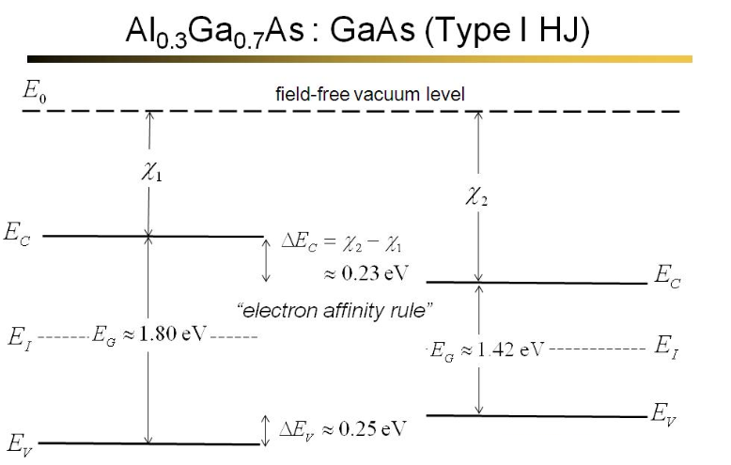
i-AlGaAs/n⁺-GaAs Heterojunction Structure
n⁺-GaAs cap
(2E18, 30 nm)
Al_{0.3}Ga_{0.7}As barrier
(undpoed, 500 nm)
n⁺-GaAs buffer
(2E18, 300 nm)
n⁺-GaAs (substrate) 350 um
Metal contact
1

Slide 2
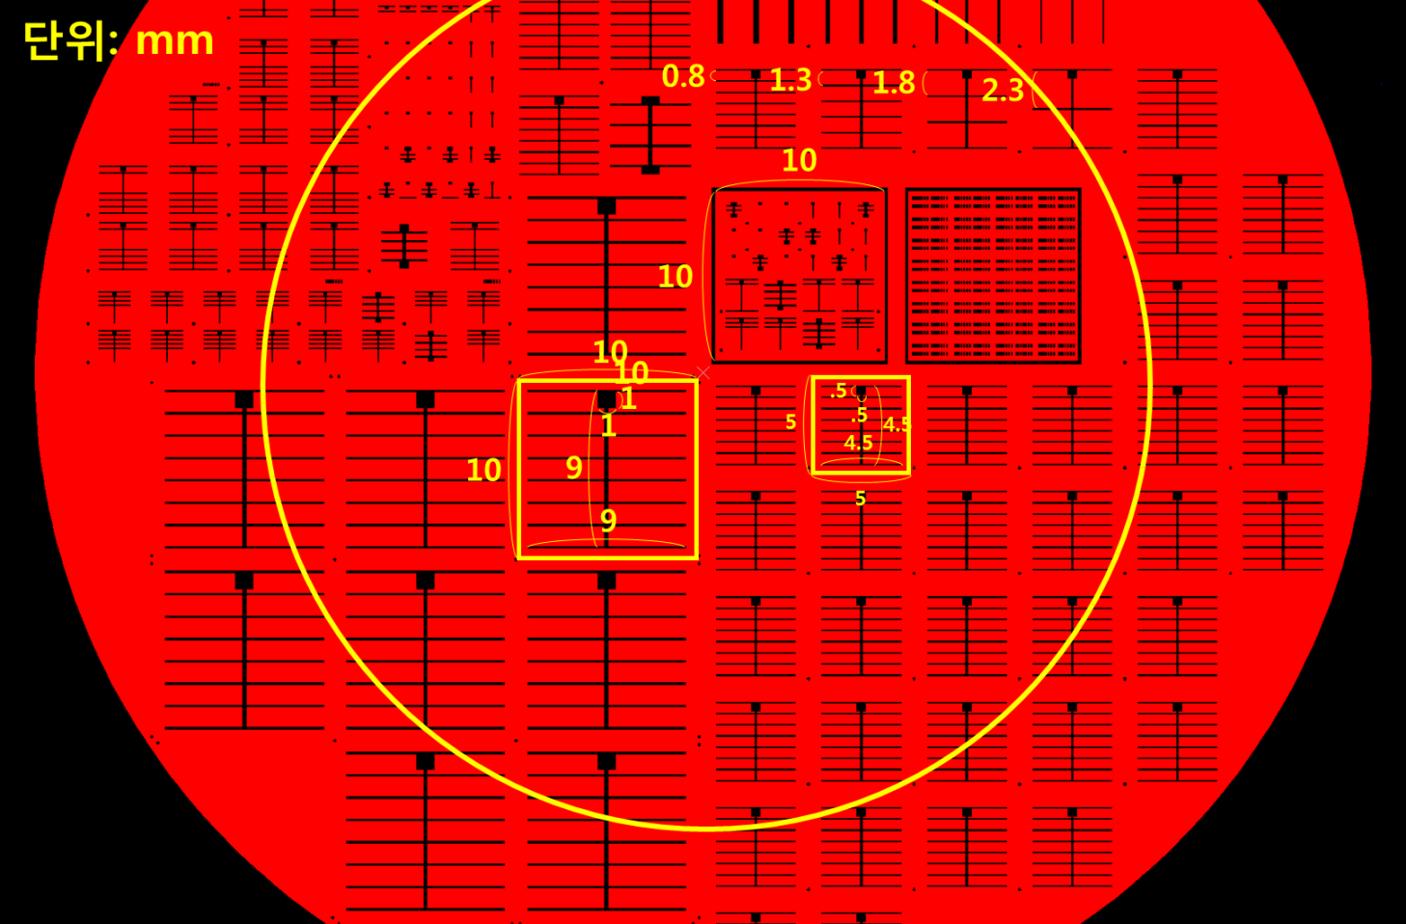
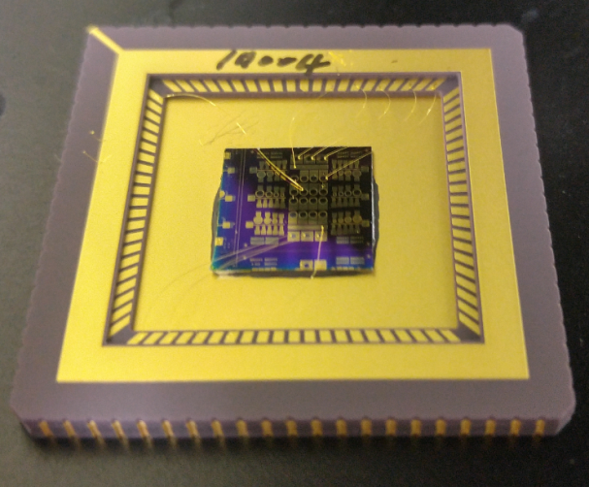
Photomask layout/LCC
Photomask
LCC
1.7 cm
~2.9 cm
2

